Slide 1
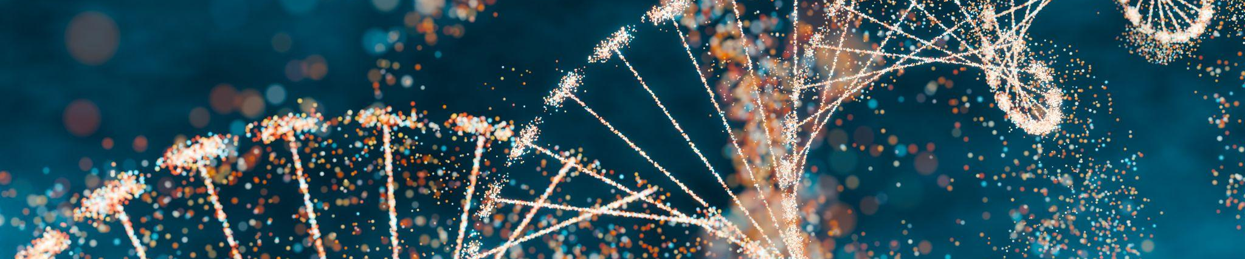


Exploring Careers in Bioinformatics
Coding Breakout – aize Group
NCRC B520 Rm 3140
August 18, 2025

Slide 2
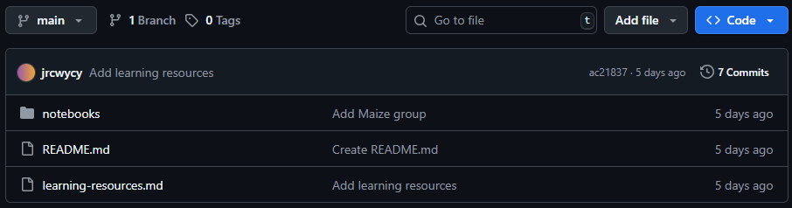
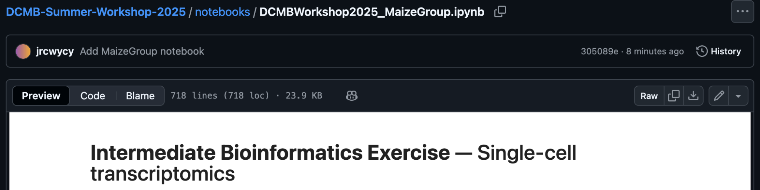
Accessing the notebook
Go to GitHub: https://github.com/lindmuir/DCMB-Summer-Workshop-2025
Go into notebooks
Download MaizeGroup notebook

Slide 3
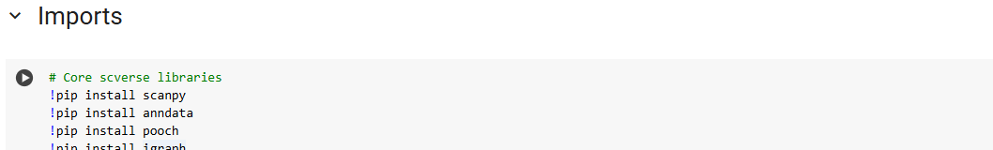
Accessing the notebook
Go to Google Colab: https://colab.google/
Login to Google account when prompted
Click “Open Colab” >> click “Upload” >> Select downloaded notebook
Run Imports block
Notes:
Mention to turn off Gemini

Slide 4
Coding Breakout
By the end of this breakout session, you will:
Load and explore a single-cell RNA sequencing (scRNA-seq) dataset in Python
Perform basic data preprocessing in Scanpy
Visualize single cells
Cluster and annotate cell types

Slide 5
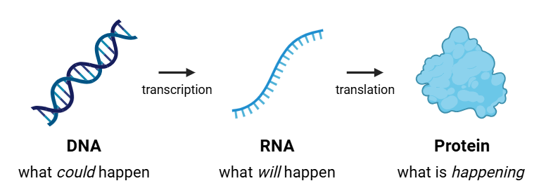
Central Dogma of Biology
Central Dogma – genetic information flows only in one direction:
Genes are segments of DNA that contain instructions for making proteins
Through transcription, a gene’s DNA sequence is copied into RNA
The RNA is then translated into proteins, which perform most of a cell’s functions
Notes:
DNA stores all genetic info → genes have instructions for making proteins

Slide 6
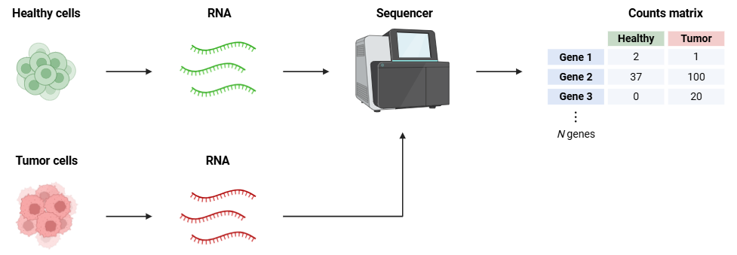
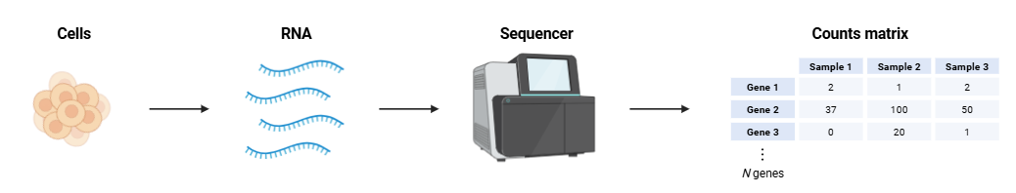
RNA sequencing
RNA levels reflect which genes are “on” in a cell
Gene expression profiling answers:
Which genes are active in a given cell?
How does gene expression change between conditions?

Slide 7


What is single-cell RNA sequencing (scRNA-seq)?
Measures gene expression in individual cells rather than a bulk sample/tissue
Captures cell-to-cell differences that get averaged out in bulk RNA-seq
Cell type A
Cell type B
Bulk RNA-seq
scRNA-seq

Slide 8
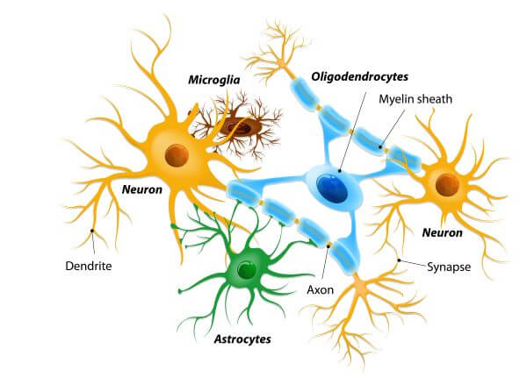
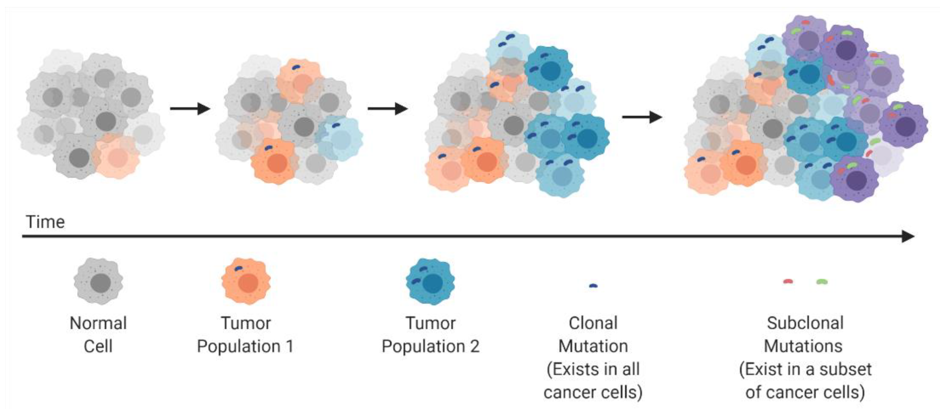
Why scRNA-seq?
Biological tissues are complex
E.g. the brain contains many different cell types
E.g. within a given tumor, multiple sub-populations of tumor cells exist
Cancers 2021, 13(4), 806; https://doi.org/10.3390/cancers13040806
Even an in vitro culture of a single cell type will display cell-to-cell differences
E.g. cells will be in different phases of the cell cycle

Slide 9
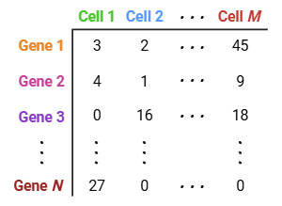
scRNA-seq Data
Output data is a counts matrix of cells x genes
Challenges:
High dimensionality
Thousands of genes per cell
True biological variation lies in fewer dimensions
Sparse (many zeros)
Most genes are not detected in each cell
Technical noise
Sequencing depth and amplification biases
Batch effects
Differences from sample prep, reagents, or time of processing
Can obscure real biological differences
Requires specialized methods to correct sources of variability and extract true biological information
N = ~20,000
Notes:
Comes with its unique challenges
Each cell is represented as a vector of expression values across all detected genes. There are about 20,000 genes so each cell lives in a ~20,000 dimensional space. The number of genes is huge compared to the number of meaningful biological signals.
Biological signals are low dimensional (even though there are 20k genes, cells usually vary along far fewer axes of biological variation (e.g., cell identity, cell cycle phase, stress response, etc.).
Very sparse, noisy, and high-dimensional → challenging to extract meaningful biological info!

Slide 10
scRNA-seq Analysis Workflow
Counts matrix
Dimensionality reduction
Quality Control
Normalization
Feature Selection
PCA
Remove low quality genes and cells
Focus on informative genes
Correct for differences in sequencing depth; scale counts
Identify main axes of variation and denoise the data
Clustering
Visualization
Cell-type Annotation
Downstream Analyses
Group cells by similar gene expression
Visualize cells in 2D
Annotate clusters by cell type
Notes:
Norm → difference in sequencing depth between cells (some cells have very few counts, others have many more counts); scales counts so each cell has comparable gene expression

Slide 11
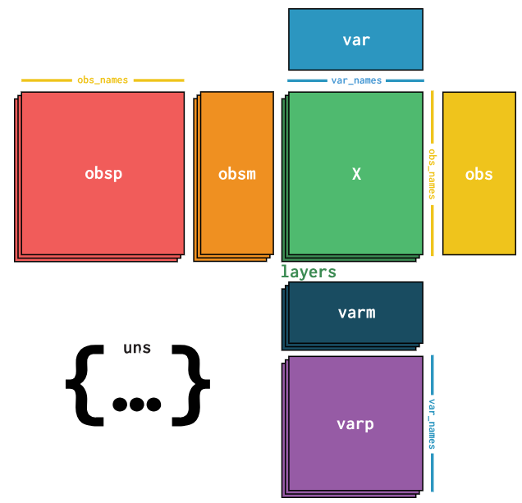
Scanpy and Anndata
Scanpy is a Python library for single-cell analysis
scanpy.pp – preprocessing
scanpy.tl – tools
scanpy.pl – plotting
Uses the Anndata object
.X = expression matrix
.obs = cell metadata
.var = gene metadata

Slide 12
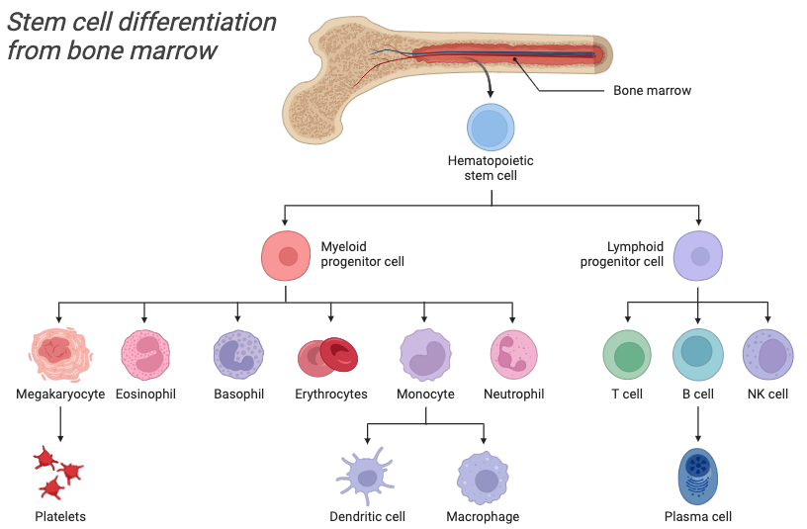
The BMMCs Dataset
The dataset we will be analyzing today was collected from bone marrow mononuclear cells (BMMCs) from healthy human donors¹
Luecken et al. (2021) A sandbox for prediction and integration of dna, rna, and proteins in single cells. In J. Vanschoren and S. Yeung, editors, Proceedings of the NeurIPs Track on Datasets and Benchmarks, volume 1. Curran. URL: https://datasets-benchmarks-proceedings.neurips.cc/paper_files/paper/2021/file/158f3069a435b314a80bdcb024f8e422-Paper-round2.pdf

Slide 13
Live Coding Overview
Together, we will:
Load in the BMMC dataset and run the preprocessing steps
Visualize the data with Uniform Manifold Approximation and Projection (UMAP)
Cluster the cells and annotate them broadly (by lineage)
Individually (or in small groups), you will:
Explore marker gene expression
Find clustering parameters that best distinguish the specific cell types we expect to see in this dataset

Slide 14
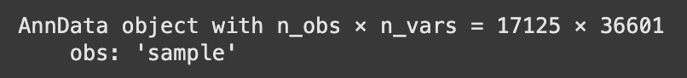
Live Coding
Load in the data
We load 2 samples, each from a different donor
cells
genes
Notes:
UMAP/clustering
Genes/cells (broad annotations)
Within cluster annotations

Slide 15
Live Coding
Load in the data
We load 2 samples, each from a different donor
Run the Preprocessing block
For today’s session, we perform all preprocessing steps and move on to clustering, visualization, and cell-type annotation
Compute nearest neighbors and visualize with UMAP
cells
genes
Notes:
UMAP/clustering
Genes/cells (broad annotations)
Within cluster annotations

Slide 16
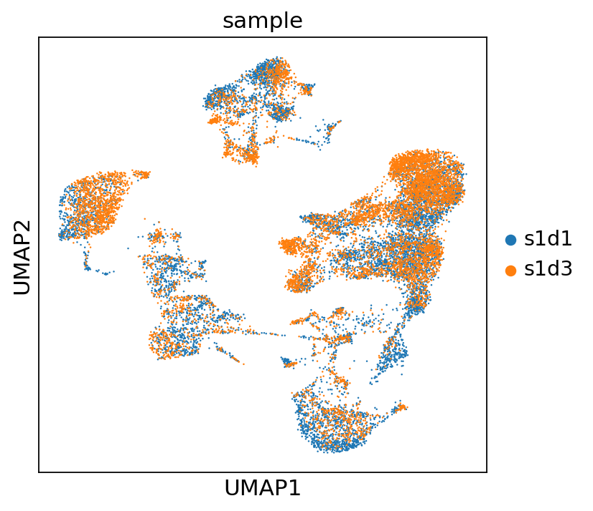
UMAP visualization
Notes:
Each dot represents a single cell
Color is the specific sample (samples mostly overlap, not a huge batch effect)

Slide 17
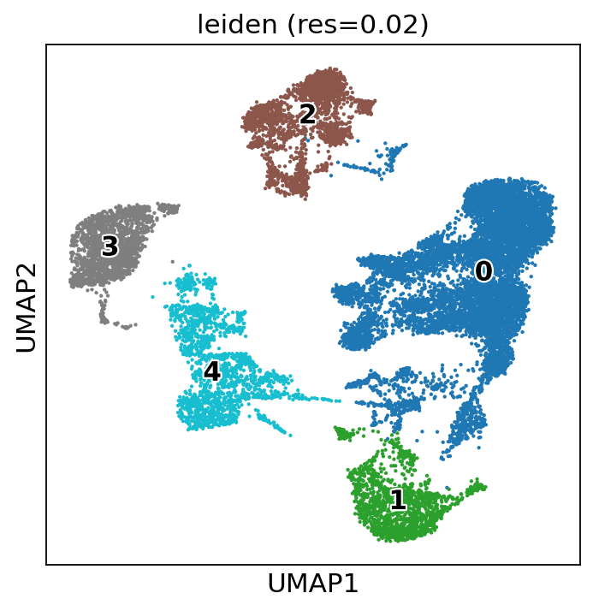
Leiden clustering

Slide 18
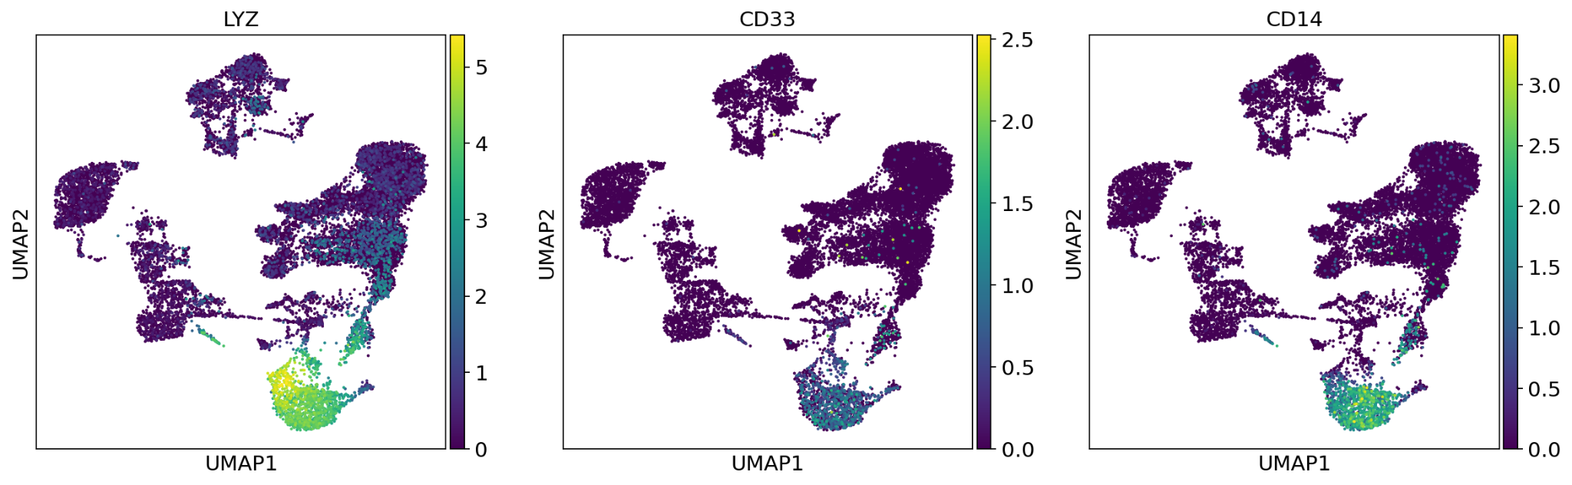
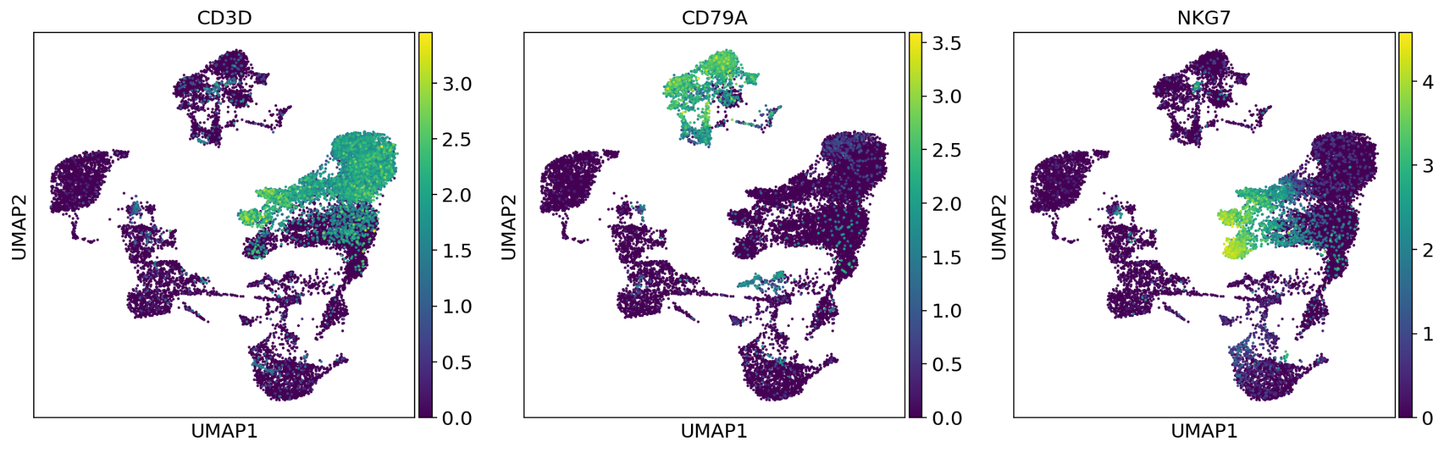
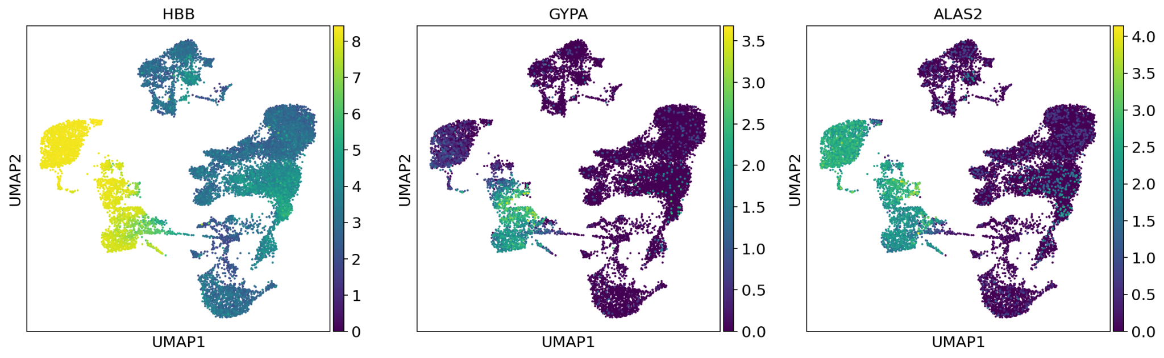
Lineage-specific gene expression
Myeloid
Lymphoid
Erythroid
Notes:
Lineage markers help to broadly annotate our clusters, but we can see that there are within-lineage differences too

Slide 19
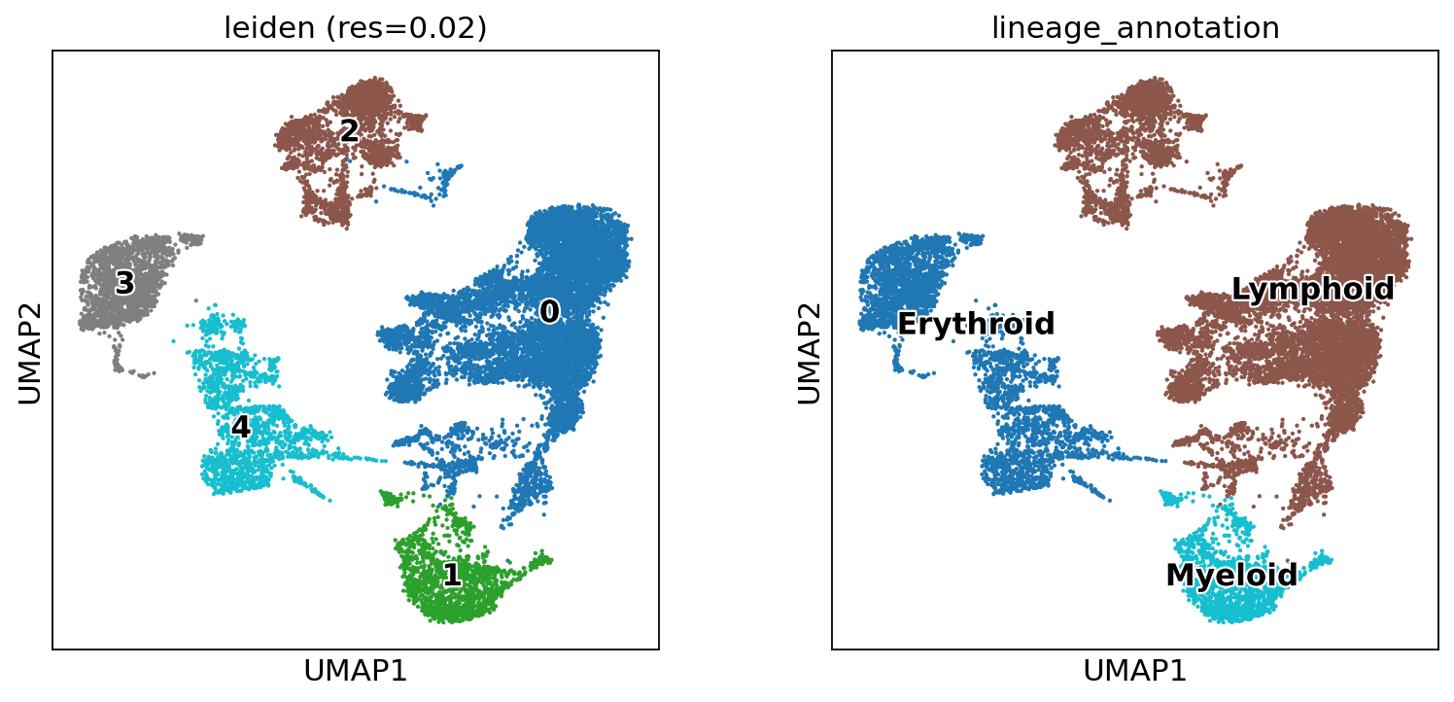
Broad cell-type annotations

Slide 20
Broad cell-type annotations

Slide 21
Hands-On Challenge: Resolving Subpopulations
GOAL: Find clustering parameters that best distinguish the expected cell types
Explore marker gene expression
Distinguish natural groupings of cells that represent known cell types
We will discuss at ~2:10pm!

Slide 22
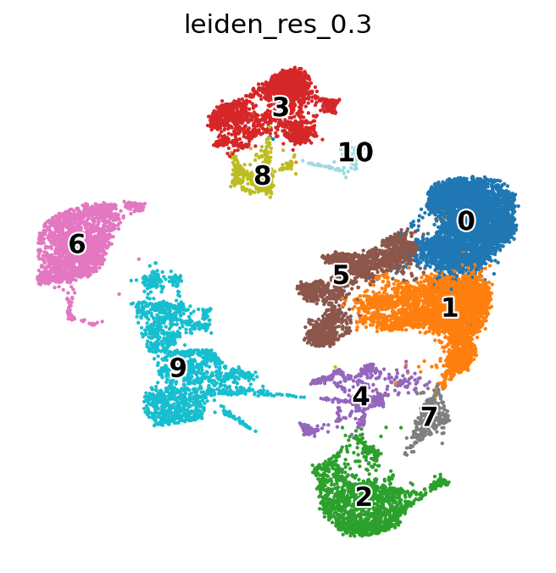
Example annotations (leiden res = 0.3)
B cells
Plasma cells
Transitional B
T cells
CD8+ T cells
T naive
Erythroblast
Proerythroblast
Monocyte

Slide 23
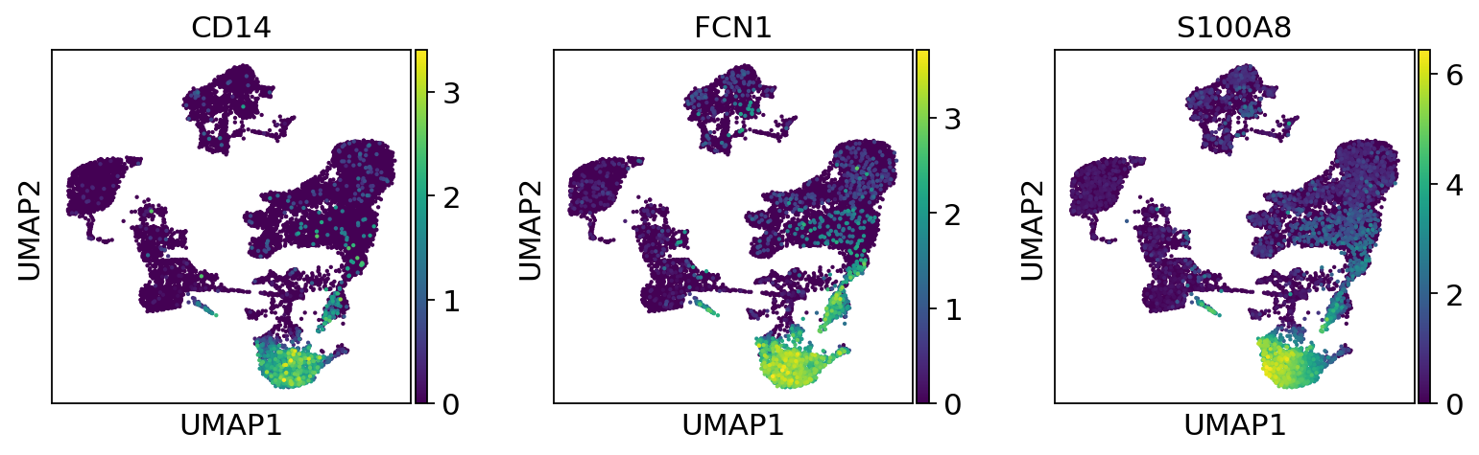
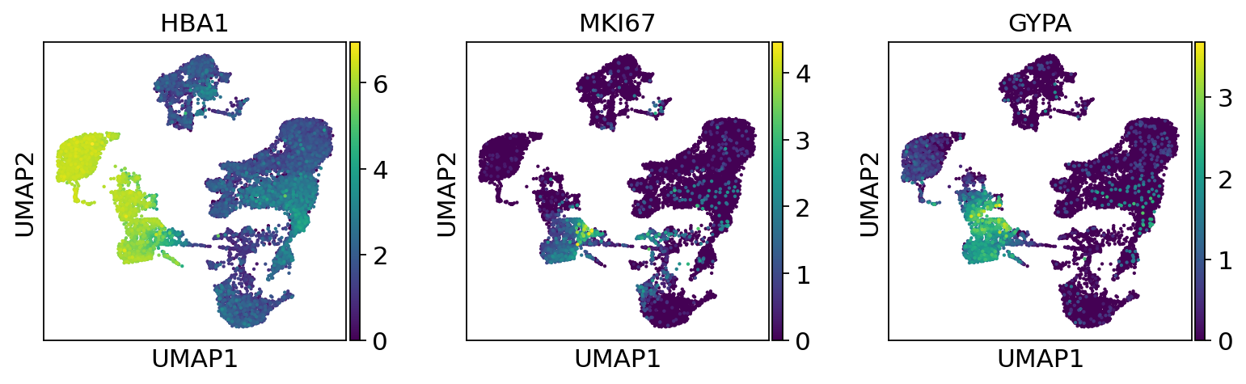
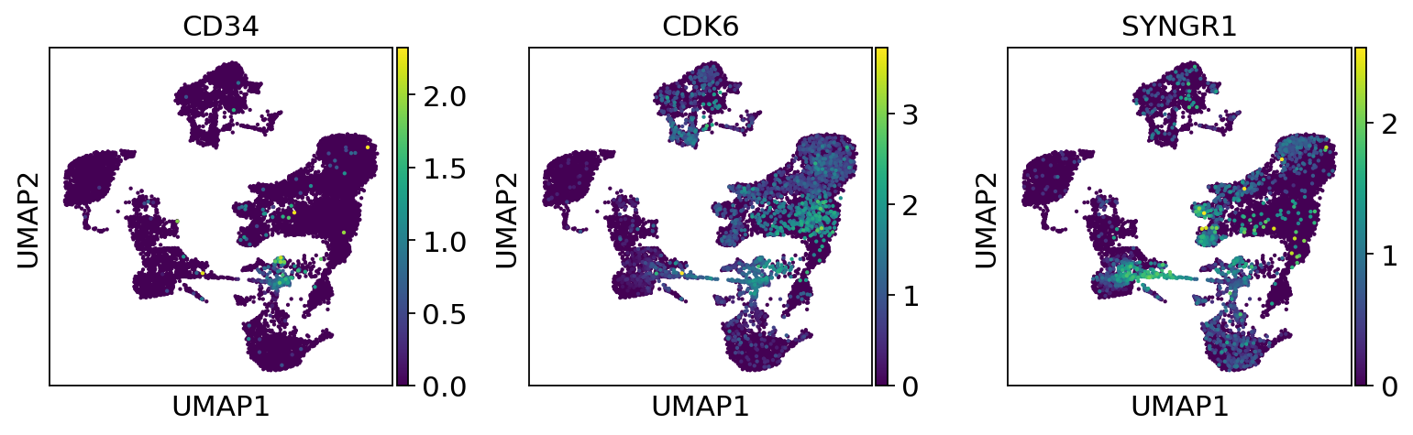
Myeloid and Erythroid Cells
Monocyte
Erythroblast
Proerythroblast

Slide 24
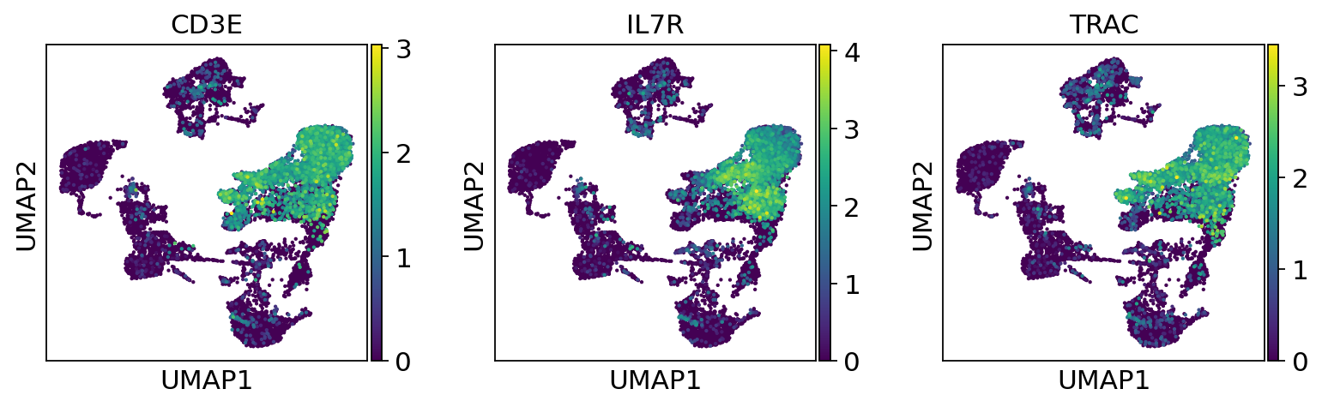
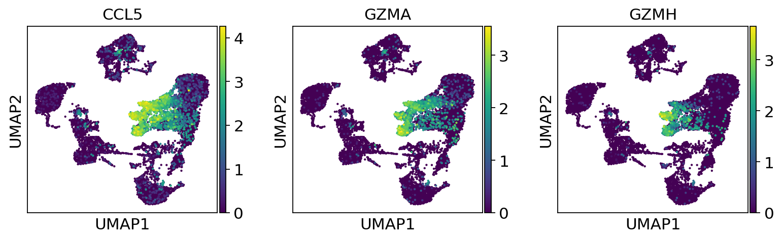
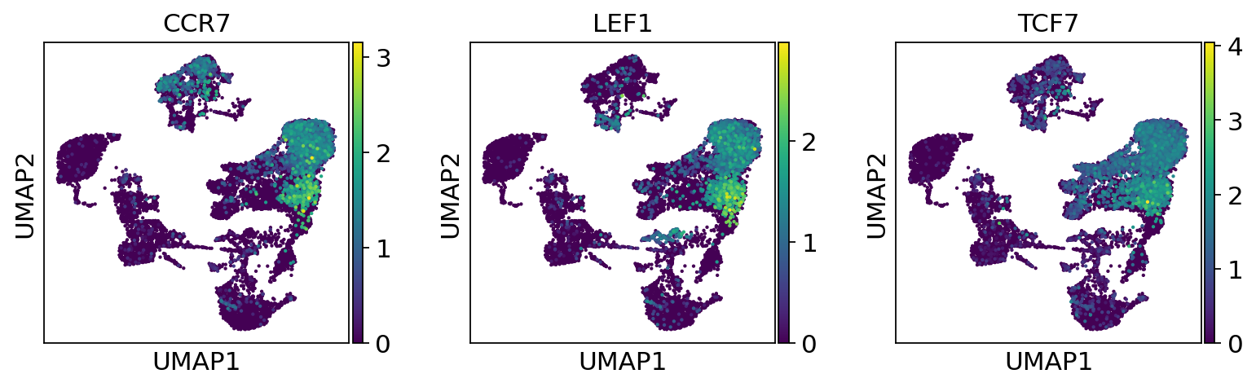
Lymphoid: T cells
T cells
CD8+ T cells
T naive

Slide 25
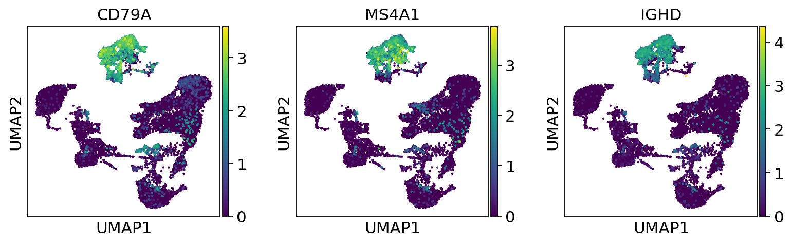
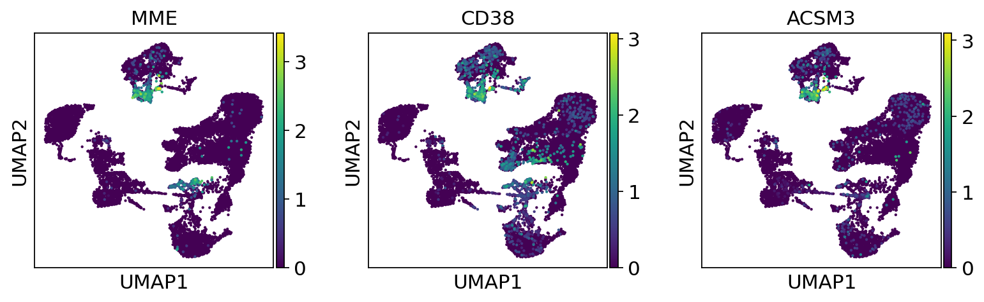
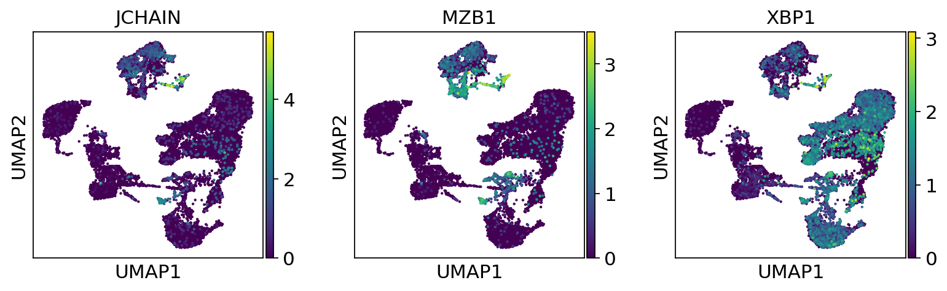
Lymphoid: B cells and Plasma
B cells
Transitional B cells
Plasma cells

